Slide 1
Effect of COVID-19 on Capital Bikeshare usage in 2019-2020
(Source: https://momentummag.com/)
Team Members
Digant Patel | Hannah Slay | John Timmers
Mike Boscia | Roderick Gee | Shailja Mathur

Slide 2
Motivation & Summary
Analyzing data from Capital Bikeshare which analyzes bike usage data from Washington DC area. We want to learn whether or not ridership was affected by the 2020 COVID-19 Pandemic.
In our analysis,
We looked at the overall monthly ridership trendlines between 2019 and 2020.
Compared usage between membership riders and casual riders.
Explored the frequency of riders through scatter plots, and
Determined what time of day riders chose to bike based on different time slots.

Slide 3
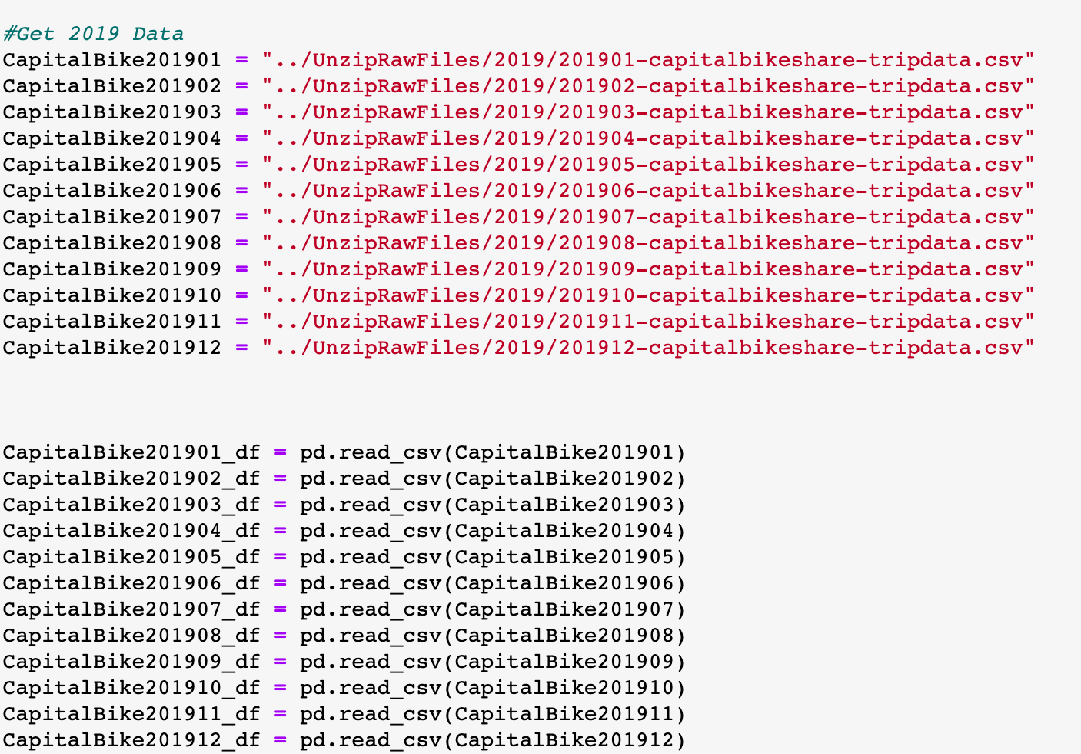
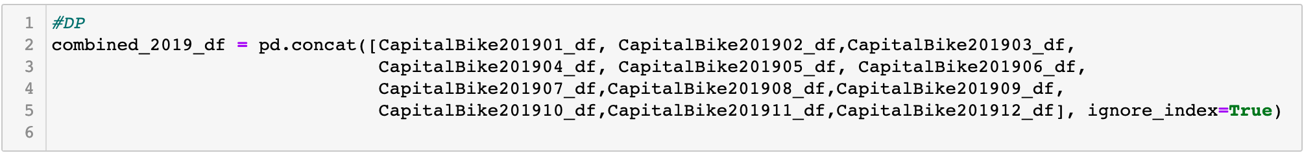
Data Load for 2019 & 2020 in to Data Frame
Merged Data

Slide 4
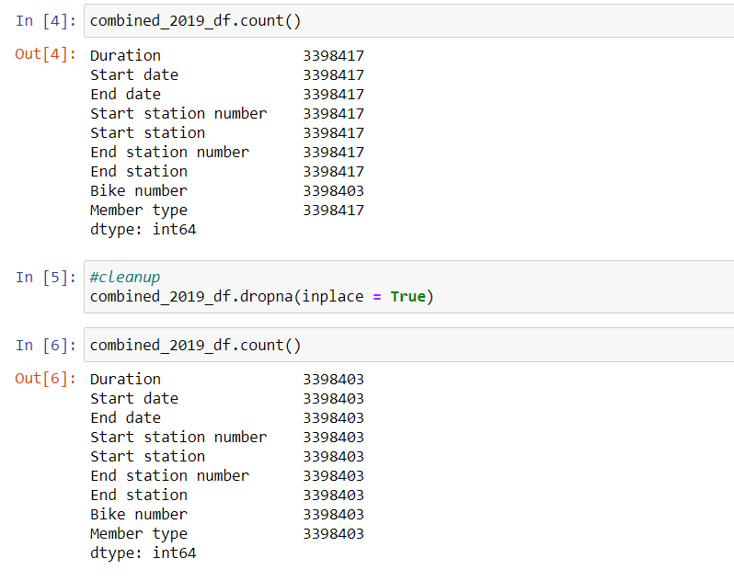
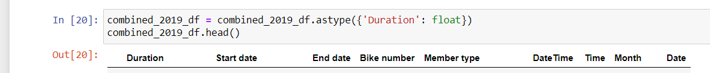
Data clean by dropping null data for 2019 and 2020

Slide 5
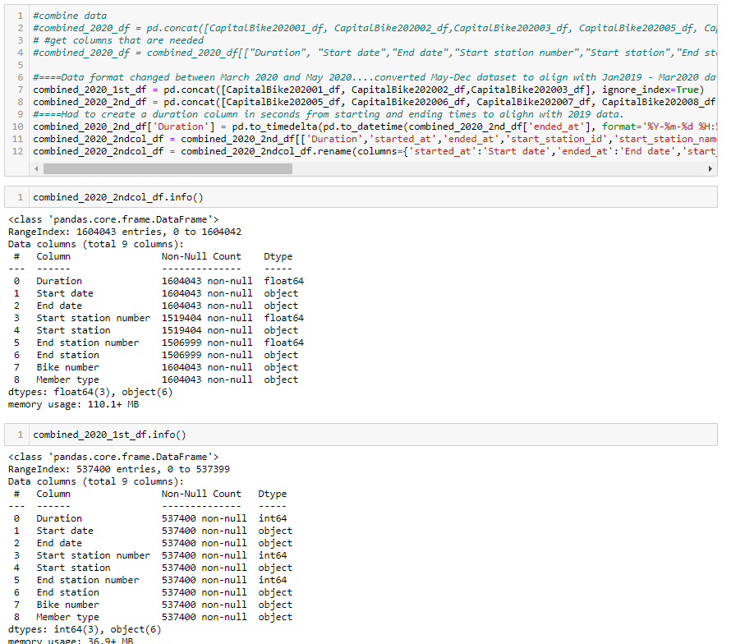
Notes:
First unexpected Data hiccup:
Company changed the format of the data files in the spring of 2020. Had to stepped process in order to align the monthly data files to be equivalent to the first 15 months of data.
Combine new format months
Drop un-matched columns that did not align with initial data format
Calculated a ride duration (in seconds) from start and end times to match up with prior year format.
Rename column headers to allow merging last 8 months of 2020 data with the first 3 months (original data format).

Slide 6
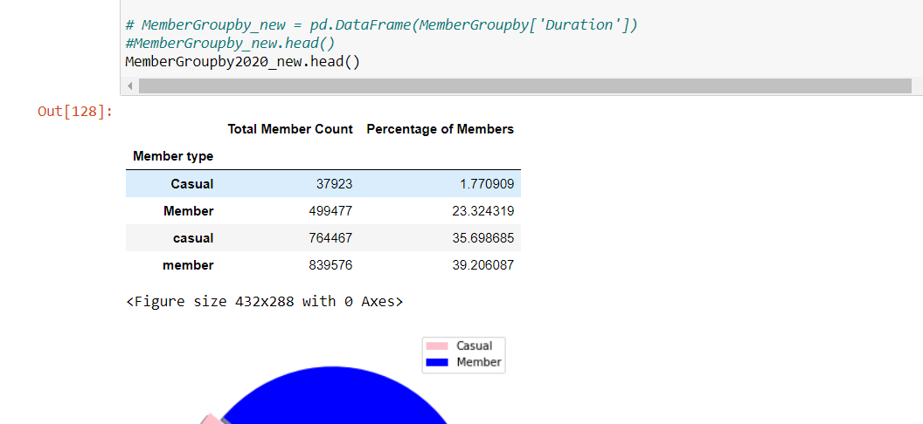
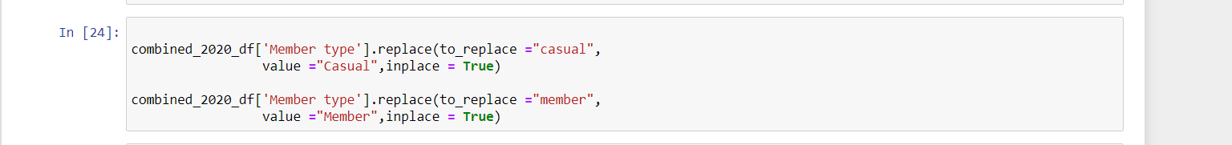
Issues after data cleaning for year 2020

Slide 7
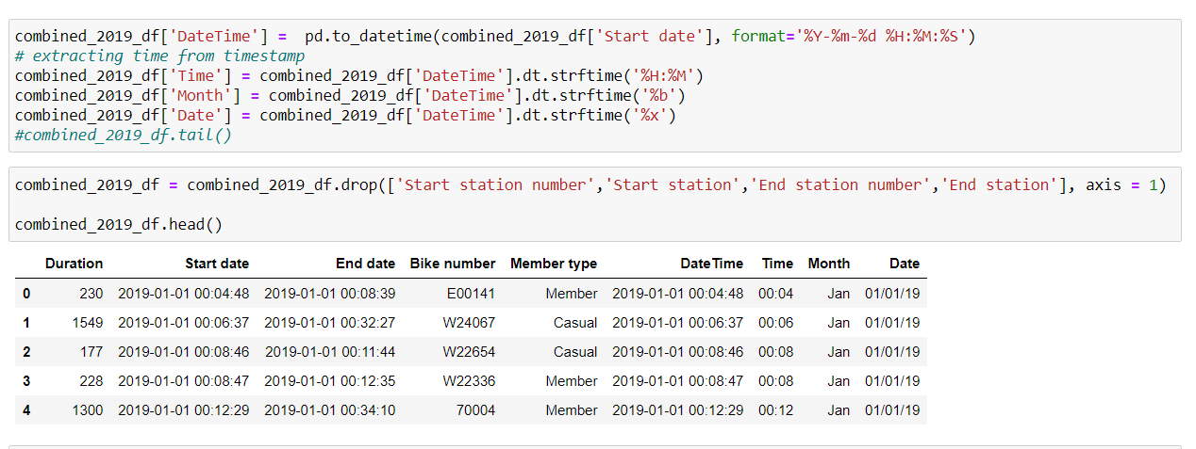
2019 - New Columns added (Time, Month, Date using Start date)

Slide 8
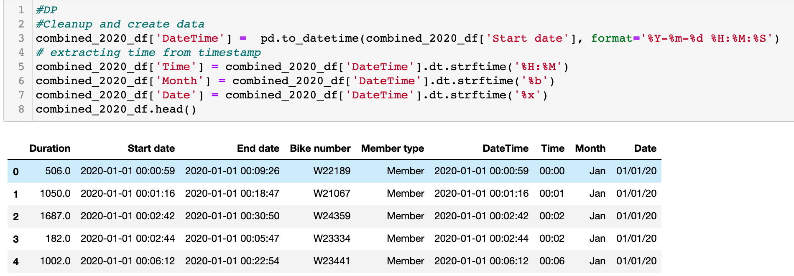
2020 - New Columns added (Time, Month, Date using Start date)

Slide 9
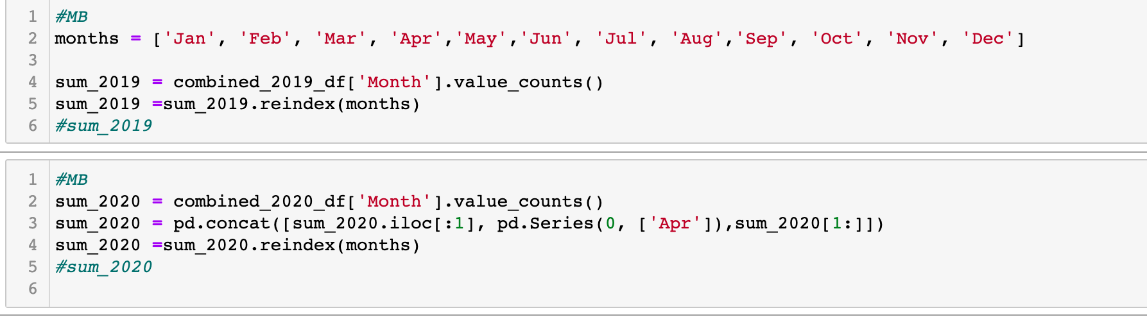
Combined Needed Columns in 2019 and in 2020

Slide 10
Capital Bikeshare 2019 v 2020

Slide 11
Capital Bikeshare 2019 v 2020 month over month

Slide 12
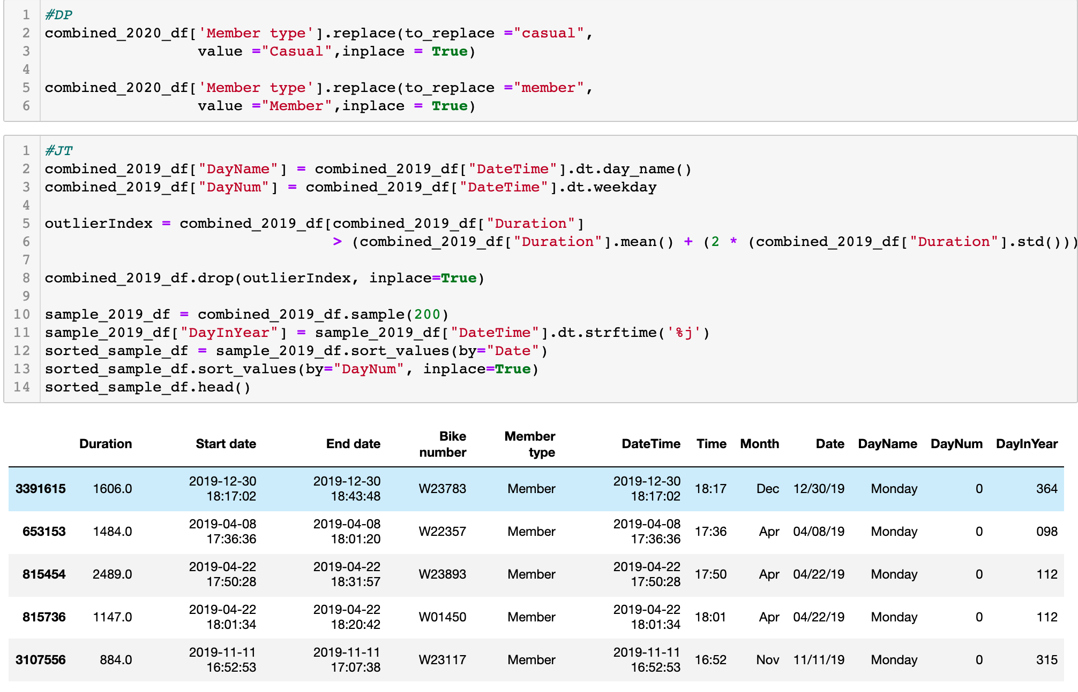

Slide 13
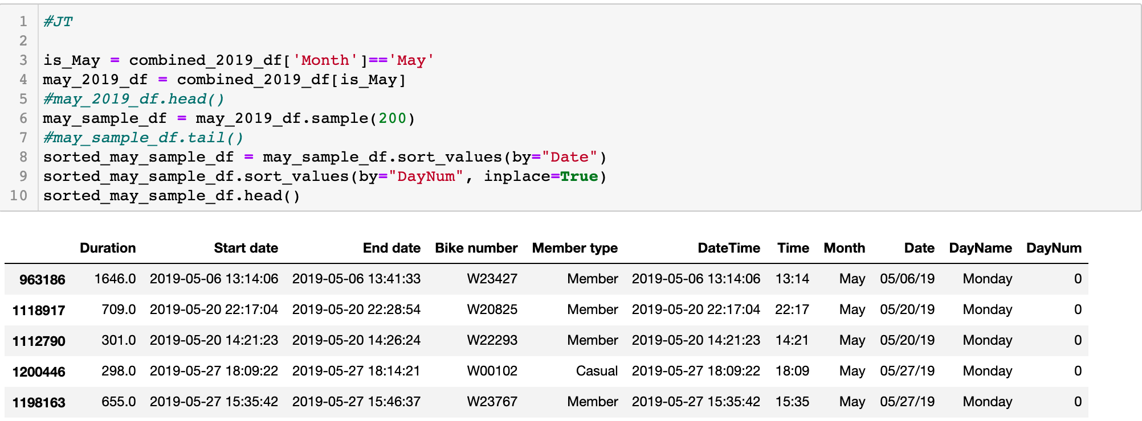
2019 May – Sorted values by ‘Date’ and ‘DayNum’

Slide 14
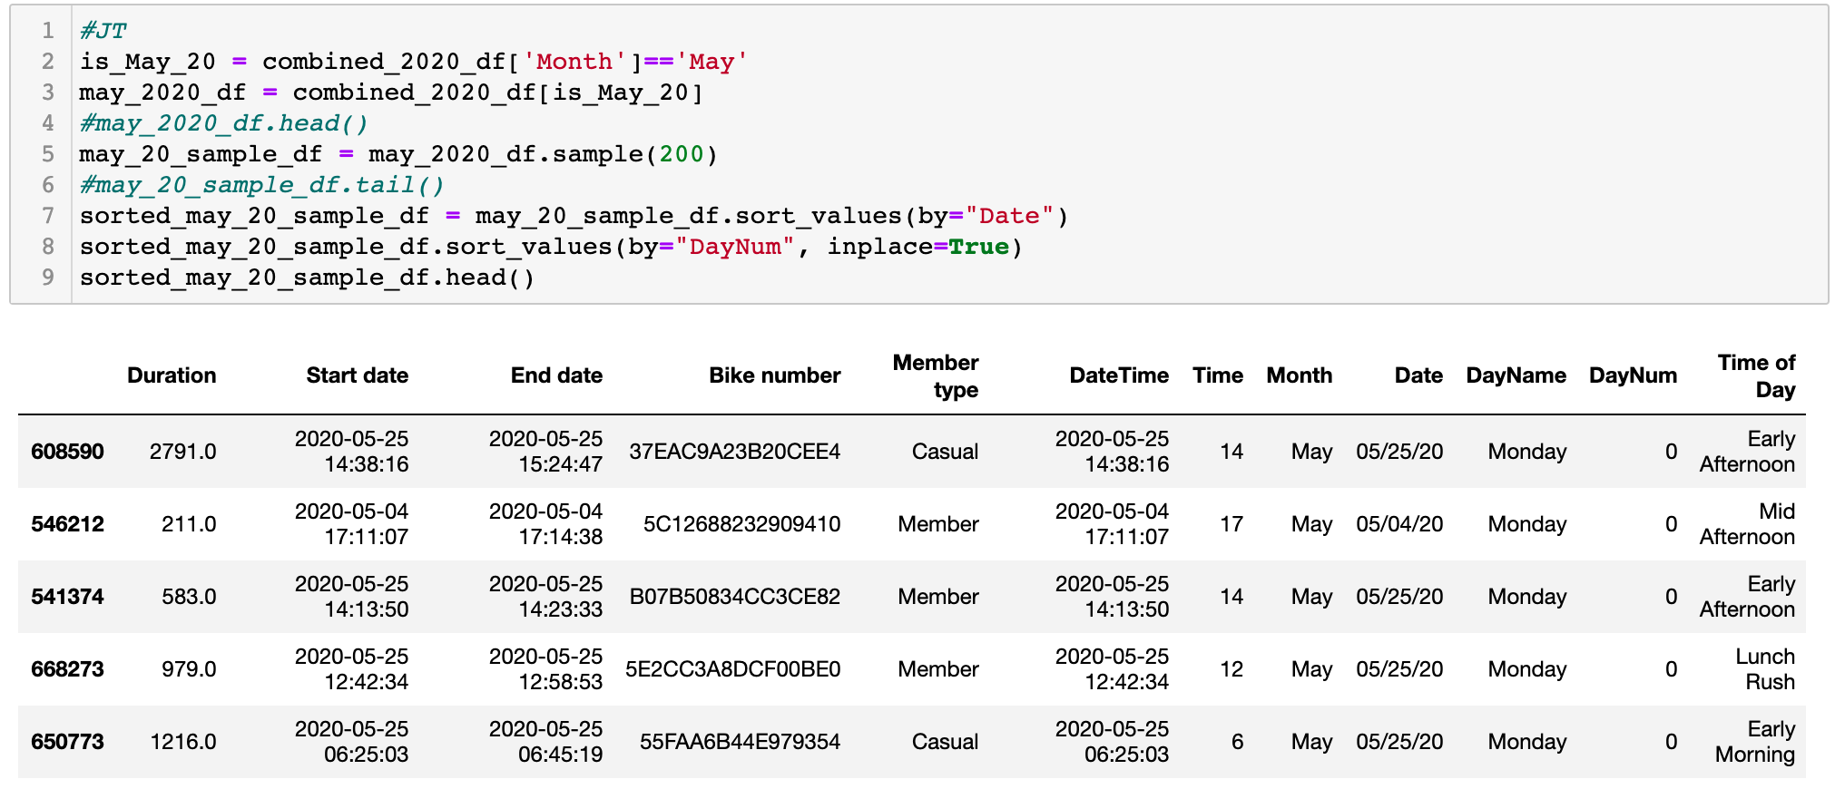
2020 May – Sorted values by ‘Date’ and ‘DayNum’

Slide 15
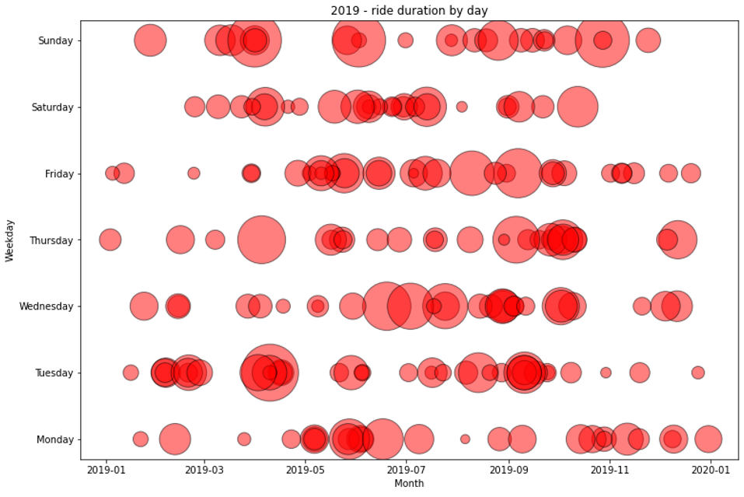
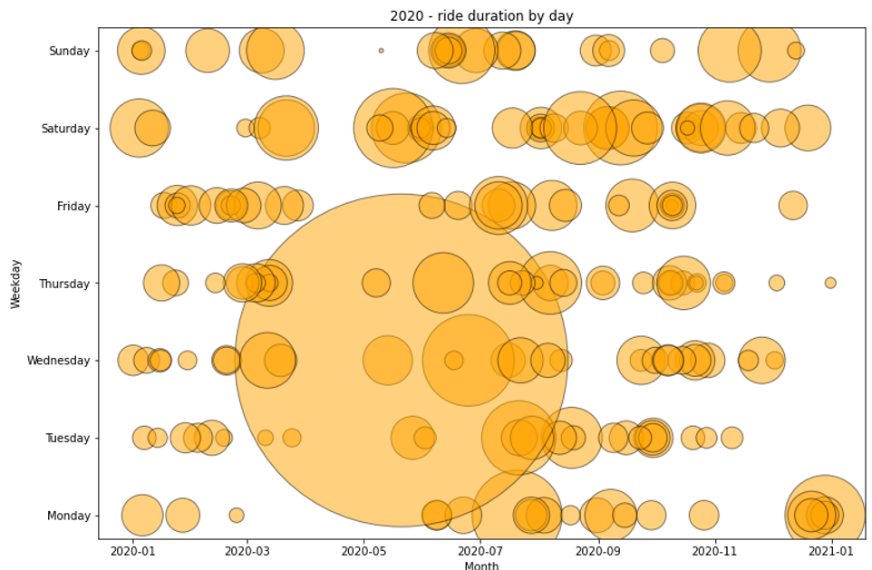
Ride duration by day – 2019 v 2020
2019
2020

Slide 16
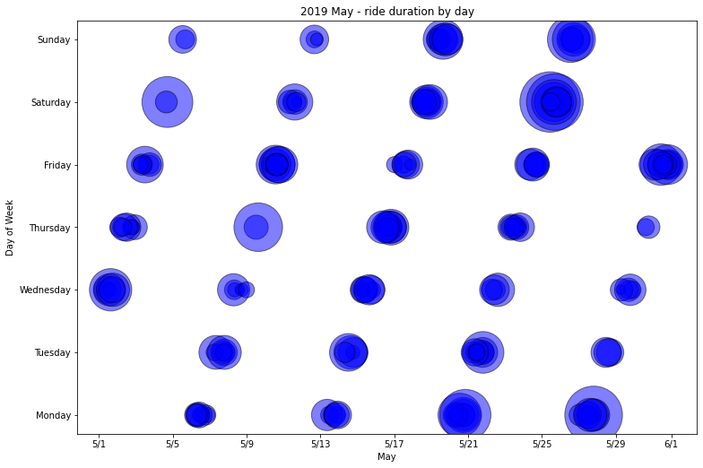
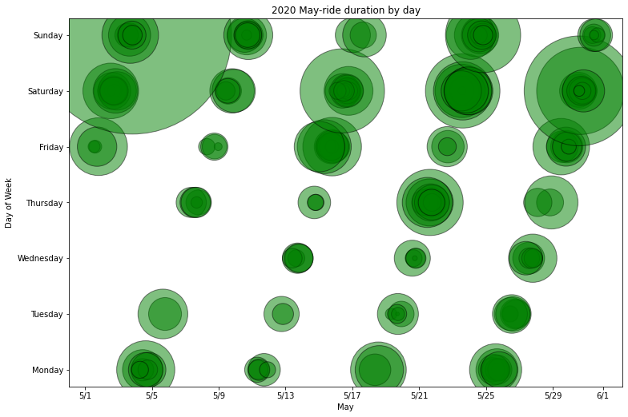
May ride duration by day - 2019 v 2020
2019
2020

Slide 17
Number of Bike Rides by Time of Day 2019 v 2020

Slide 18
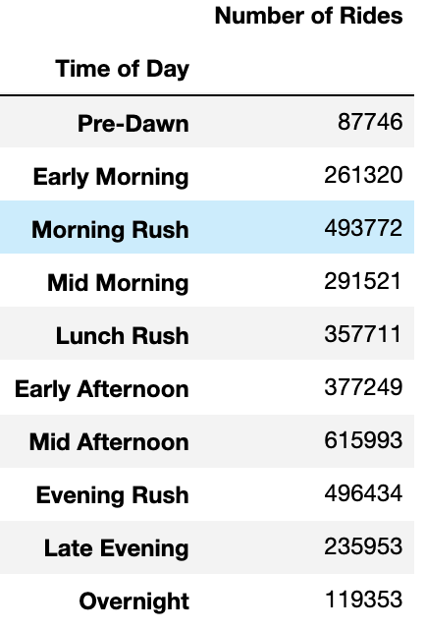
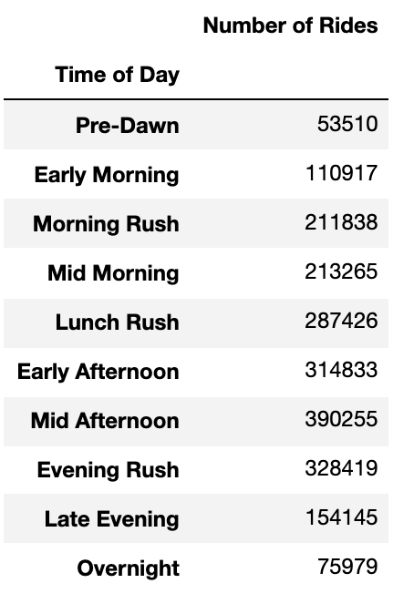
Number of rides in different times of day - 2019 v 2020
2019
2020
Notes:
Significant reduction in 2020 is observed

Slide 19
Member Type Ridership – 2019 vs 2020
2019
2020

Slide 20
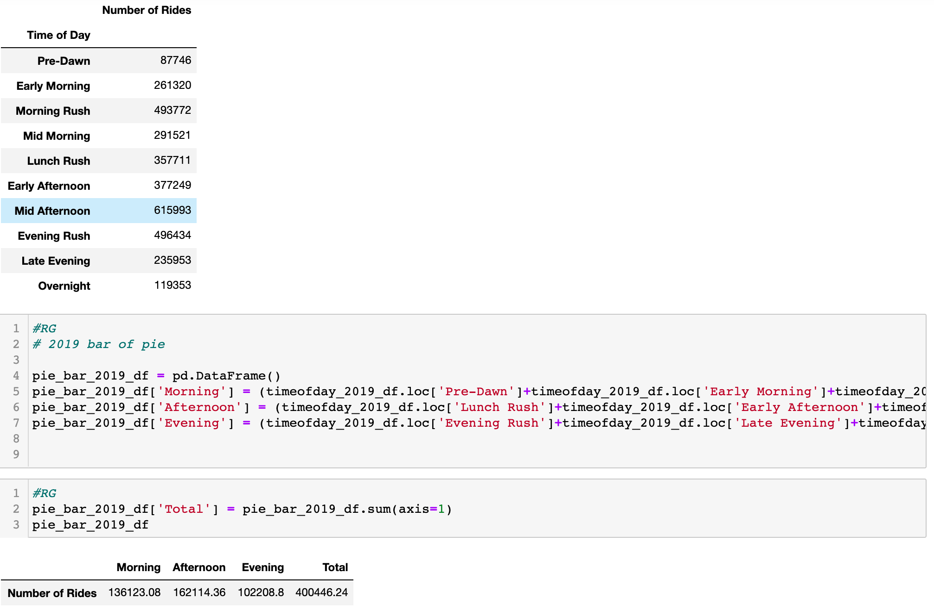
2019 - Total number of Casual riders

Slide 21
2019 Member Type Ridership

Slide 22
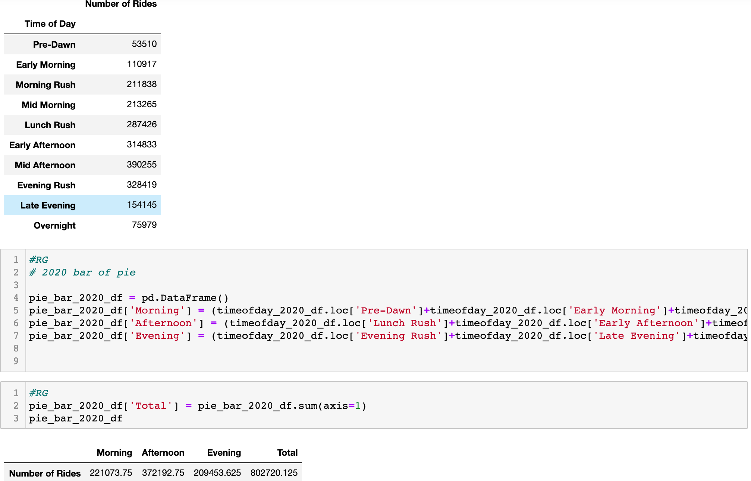
2020 - Total number of Casual riders

Slide 23
2020 Member Type Ridership

Slide 24
Conclusion
Bikeshare usage reduced significantly between 2019 and 2020 when compared month by month.
While the volume of riders reduced, a drastic shift in rider type is observed.
Year | Total Riders | Percent Change
2019 | 3337052 | -56%
2020 | 2140587
Rider Type | 2019 | 2020 | Percent Change
Casual | 401046 | 801634 | 100%
Member | 2936006 | 1338953 | -54%
Notes:
We looked at the overall monthly ridership trendlines between 2019 and 2020.
Compared usage between membership riders and casual riders

Slide 25
Conclusion
The frequency of riders is observed to be more erratic or random in 2020 when compared to 2019 based on the scatter plots.
However, while the number of casual riders increased by 50% the ride time of day variance among casual riders remained about the same between 2020 and 2019. For example, 46% of Y2020 casual riders preferred riding in the afternoon as opposed to 40% of Y2019 casual riders.
Overall, the trend of bike share remained the same between 2019 and 2020 but with a significant reduction in volume in 2020, which is due to the pandemic and lockdowns.
Notes:
Explored the frequency of riders through scatter plots, and
Determined what time of day riders chose to bike based on different time slots

Slide 26
QUESTIONS?

